Slide 1

Detection with DASS
Twilla Gerling
&
Jamie Mortensen

Slide 2

The Question:
How well do temperament and demographics predict a person’s likelihood to suffer from severe depression, anxiety, or stress issues?

Slide 3
The Data
Results of an interactive version of the Taylor Manifest Anxiety Scale
Forty-two questions about thoughts/feelings
Time elapsed & position included as well
Ten Item Personality Inventory questions
Sixteen Words you may know
Eighteen demographic questions
172 columns in original dataset
Stress | Depression | Anxiety

Slide 4
Pre-Processing
Handle Nulls
‘Major’ Pain
Outliers
Dropped Columns
Only in ‘Major’ and ‘Country’ columns
4500 majors processed to under 100
Ages over 1900 and family sizes over 120!
Some columns did not add values, such as elapsed time and position

Slide 5
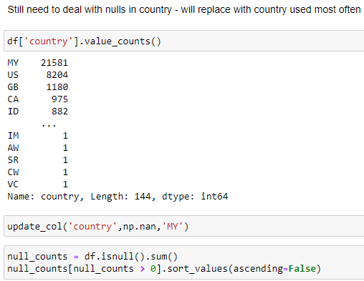
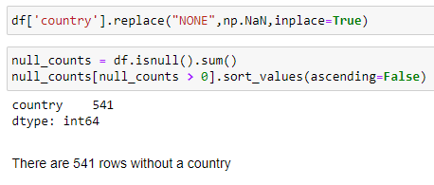
Handling Nulls

Slide 6
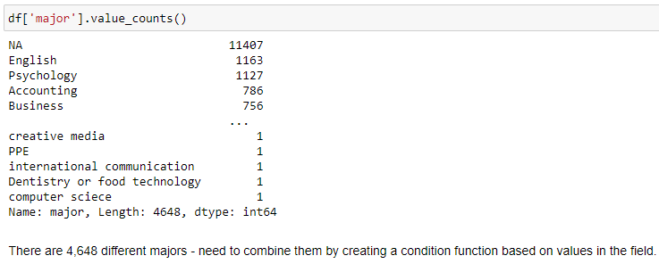
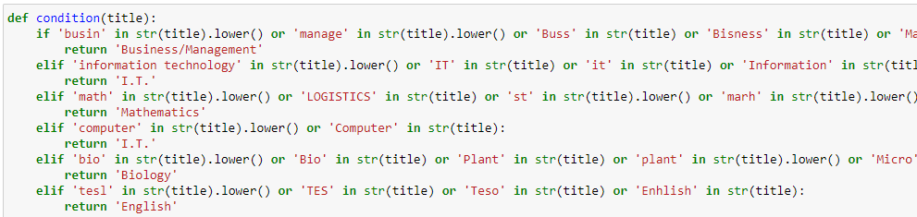
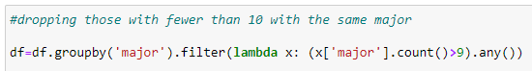
‘Major’ Pain

Slide 7
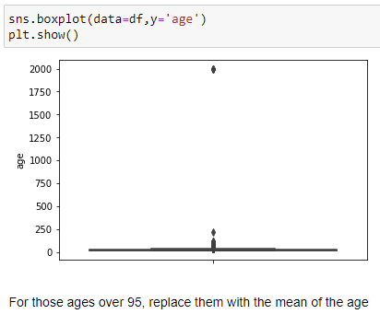
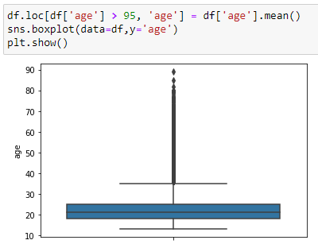
Outliers

Slide 8
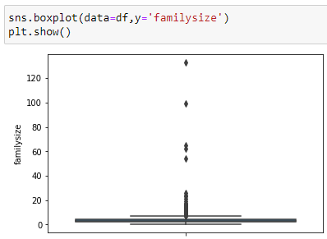
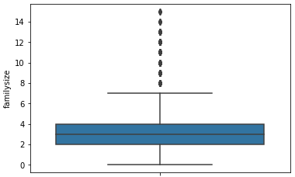
Outliers

Slide 9
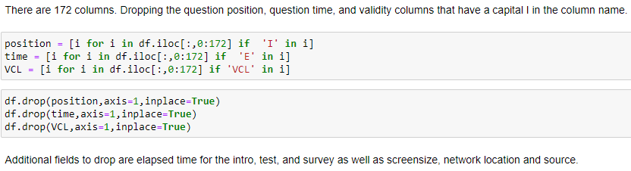
Dropped Columns
Final number of columns after preprocessing = 34

Slide 10

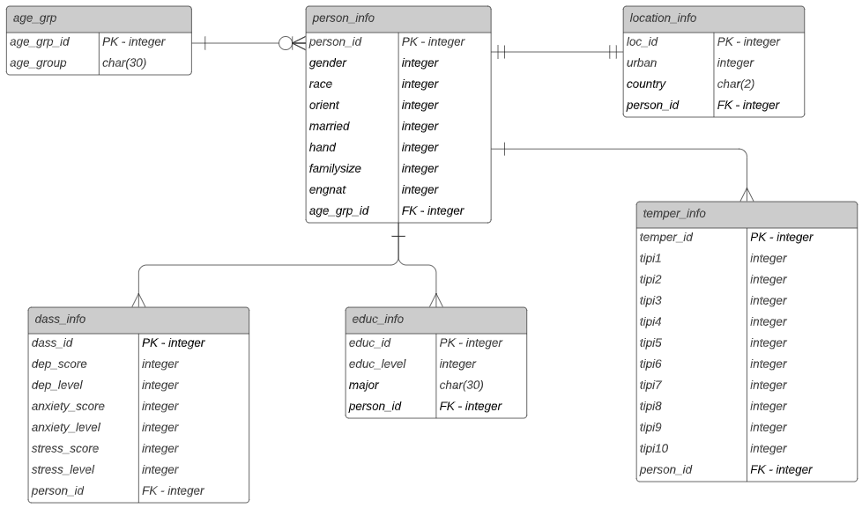
The Model
The Database Model

Slide 11

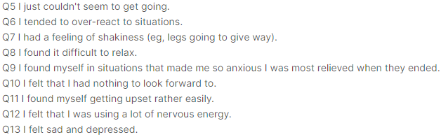
The DASS Scales

Slide 12
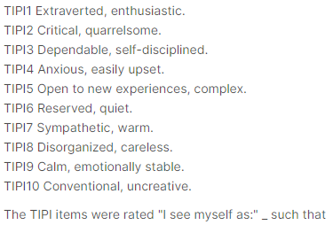
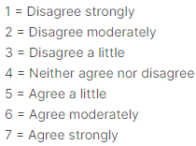
The TIPI

Slide 13
The Process
Developing a Supervised Machine Learning Model
Dimensionality Reduction
Ensemble Learning
Parameter Tuning
Oversampling
Cross-Validation
Use Principal Component Analysis (PCA)
Use Random Forest Classifier, K Neighbors Classifier, and a Voting Classifier
Use GridSearchCV to optimize parameters
Balance the data using Synthetic Minority Oversampling Technique (SMOTE)
Use GridSearchCV to cross-validate while tuning parameters (10 folds)

Slide 14
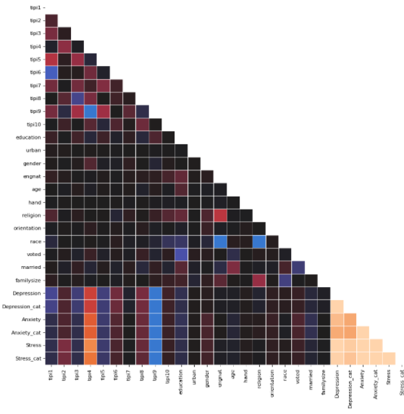

Dimensionality Reduction
Strong multicollinearity among 42 questions
No correlations to be wary of here
Ran PCA to confirm

Slide 15
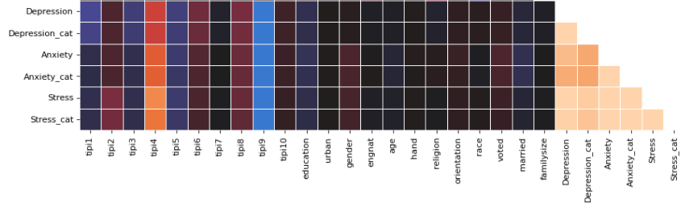
Dimensionality Reduction
tipi4 - Anxious, easily upset
tipi9 - Calm, emotionally stable

Slide 16
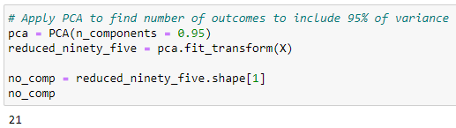
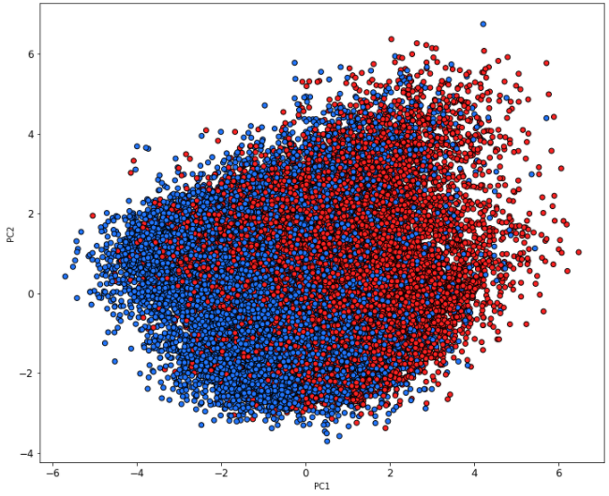
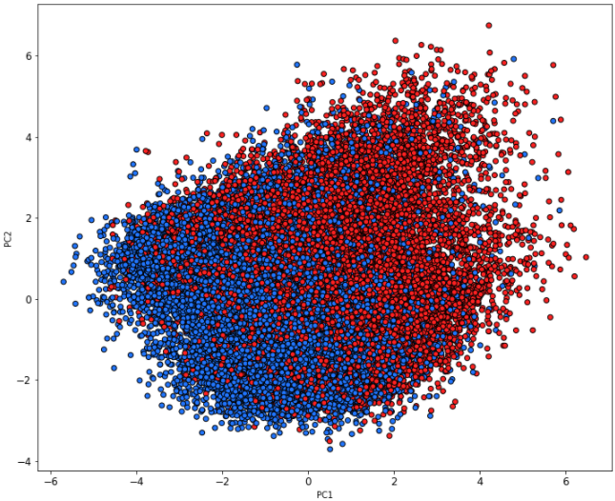
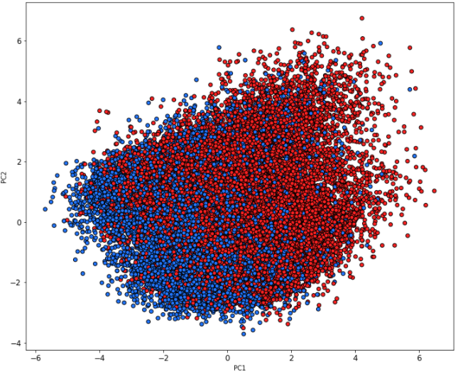
Principal Component Analysis
Optimal number of components = 21
Total features in dataset = 21
No Severe Depression
No Severe Anxiety
No Severe Stress
Severe Depression
Severe Anxiety
Severe Stress

Slide 17
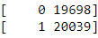
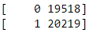
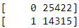
Before Oversampling
Balance of Outcomes for Depression
Balance of Outcomes for Anxiety
Balance of Outcomes for Stress

Slide 18
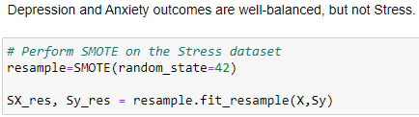
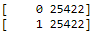
After Oversampling
Balance of Outcomes for Depression
Balance of Outcomes for Anxiety
Balance of Outcomes for Stress

Slide 19
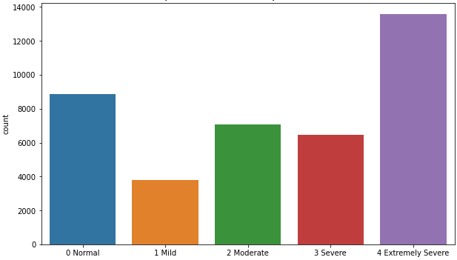
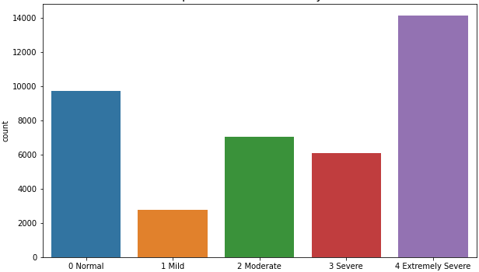
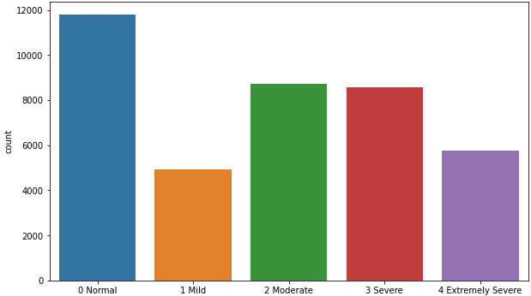
The Model
We needed to narrow our efforts to one of the ‘conditions’ in the dataset for more in-depth analysis, so we chose the Stress Dataset. This is the most imbalanced dataset with the lowest predictability at the extremes.
Depression Level Counts
Anxiety Level Counts
Stress Level Counts
We classified a binary outcome for ‘severe’ and ‘extreme severe’ stress versus ‘normal,’ ‘mild,’ or ‘moderate.’

Slide 20


The Model
~ Ensemble Learning ~
We used a Random Forest Classifier, as well as a K Neighbors Classifier.
We also incorporated a Voting Classifier to further improve the model.

Slide 21
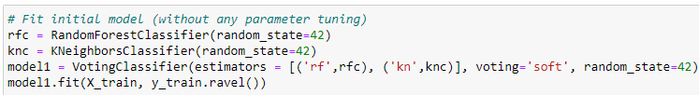
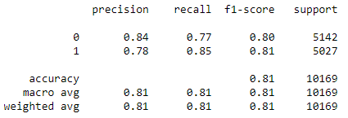
The Model
~ Ensemble Learning ~

Slide 22
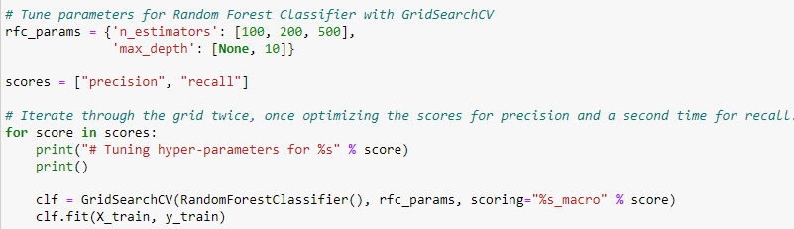
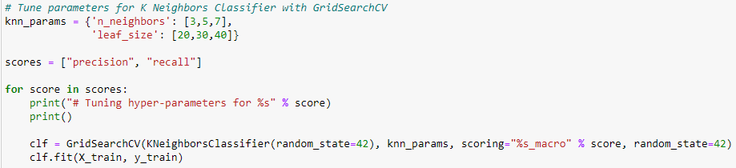
Cross-Validation
We used GridSearchCV (with 10 folds) to assess the performance of the model after fitting it to the training dataset.

Slide 23
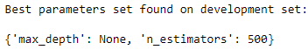
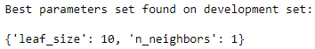
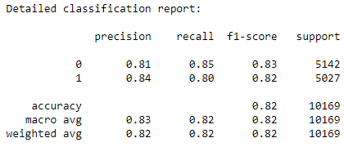
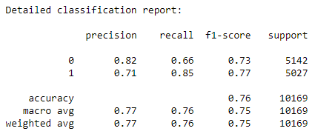
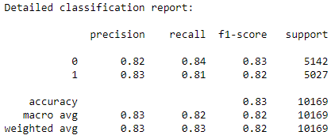
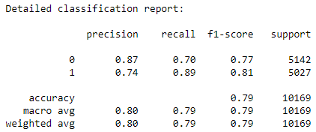
Parameter Tuning
We tuned the parameters with GridSearchCV, which applies cross-validation in its process. After tuning the parameters based on the GridSearchCV results, we fit the model with the optimal parameters to the test dataset.
Random Forest Classifier
K Neighbors Classifier

Slide 24
Parameter Tuning
When fitting the last model based on tuning each estimator to its optimal parameters, we ran the ensemble again. Surprisingly, this model did not perform as well as the model that used only Random Forest Classifier with 500 trees.

Slide 25
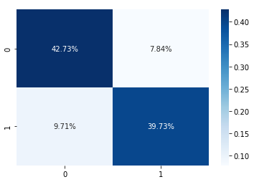
The Performance Metrics
Recall
Precision
Accuracy
80% for ‘carriers 85% for ‘noncarriers’
84% for ‘carriers’ 81% for ‘noncarriers’
82%

Slide 26

The Findings
It is in fact possible to determine,
with a reasonable level of confidence, a person’s likelihood to suffer from severe stress issues based on their temperament and other demographic information such as age, gender, race, and level of education.

Slide 27
The Lessons Learned
More data is good, but only if it’s clean data.
Don’t get too fancy!
We still have more to learn about Git Bash.

Slide 28

The Conclusion
Not one of us is depressed, anxious, or stressed after today because
WE DID IT!

Slide 29
Westport SOCIAL
March 19
6:00pm
BE THERE!

